Slide 1

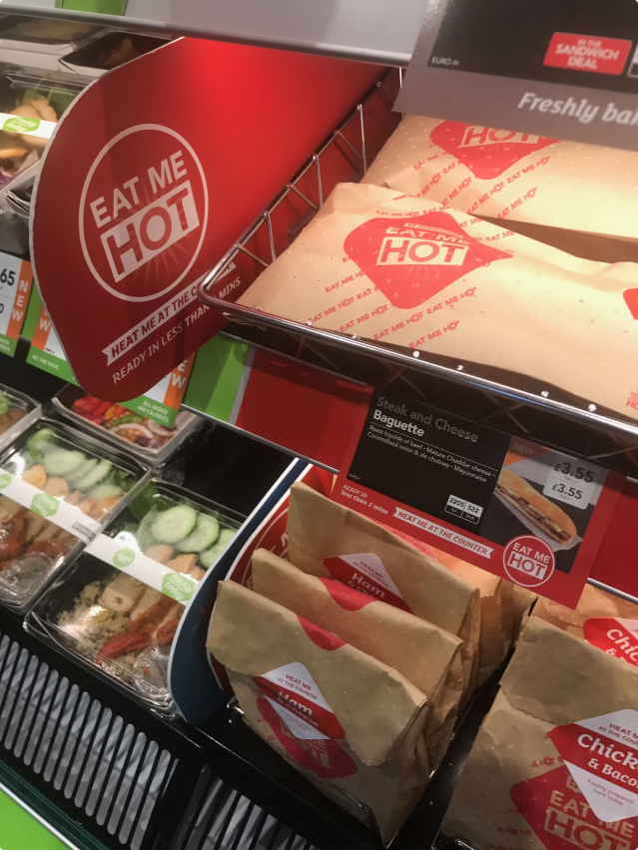
Product Recommendations for New Stores
This presentation provides tailored product recommendations for three different store types: 5.5K Stores, EDO Stores, and Travel Stores. The recommendations aim to maximize profitability and cater to the unique needs of each store's customer base.
by Prafulla Nirmale
PN

Slide 2
5.5K Stores
(Located in cities/populated areas)
Recommendation
Current Product Mix
Maximize variety and convenience in offerings, with a strong focus on ADV Pizza and Bean to Cup, while exploring growth opportunities for Chicken and Frozen Yogurt.
ADV Pizza: 56%, Bean to Cup: 28%, Chicken: 4%, Door Dash: 3%, Frozen Yogurt: 9%.

Slide 3
EDO Stores
(Cross between 5.5K and Travel Center)
Recommendation
Current Product Mix
Prioritize ADV Pizza and Chicken, with a focus on quality and variety to cater to a mixed customer base of travelers and locals. Limited focus on DoorDash.
ADV Pizza: 46%, Bean to Cup: 22%, Chicken: 23%, Door Dash: 0%, Frozen Yogurt: 10%.

Slide 4
Travel Stores
(Along travel routes, not in populated areas)
Recommendation
Current Product Mix
Emphasize quick service and convenience for ADV Pizza and Bean to Cup, catering to the needs of long-haul travelers with hearty Chicken options and light Frozen Yogurt treats.
ADV Pizza: 41%, Bean to Cup: 24%, Chicken: 23%, Door Dash: 2%, Frozen Yogurt: 10%.

